Slide 1
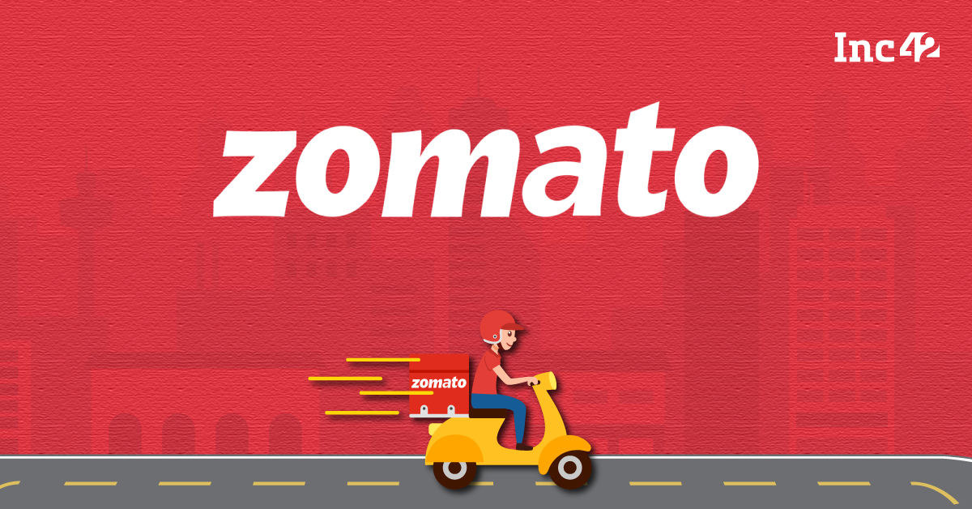

Zomato Restaurant Analysis
Dive into the world of Zomato, exploring key insights and trends in restaurant data.
By- Seema Parmeshware
- Nandini
- Bhavani
- Bhargavi

Slide 2

Introduction
Zomato is an Indian multinational restaurant aggregator and food delivery company.
It was founded by Deepinder Goyal and Pankaj Chaddah in 2008.
Zomato provides information, menus and user-reviews of restaurants as well as food delivery options
from partner restaurants in more than 1,000 Indian cities and towns, as of 2022–23.[Zomato rivals Swiggy in food delivery and hyperlocal space.

Slide 3
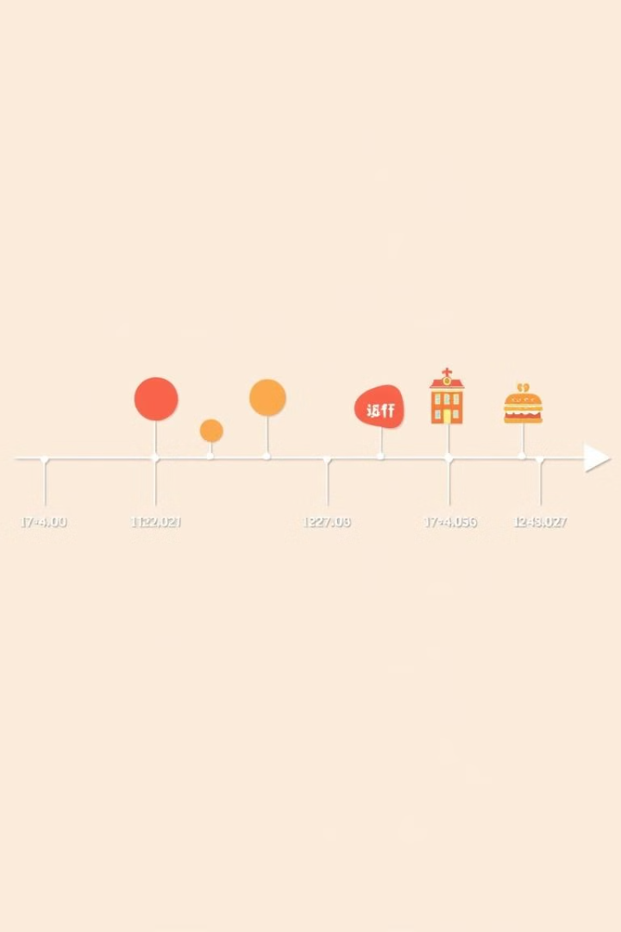
Objective:
The Project’s objective is to study the restaurant scenario in many locations across the world by using the Zomato restaurant information. Restaurants are an important part of a city’s economy because they mostly rely on Food sales revenue.
The main objective is to identify the crucial factors affecting a restaurant’s performance across multiple cities. With this information, plans may be created and informed decisions may be made to enhance restaurant operations, enhance patron experiences, and promote industry expansion.

Slide 4
Tools used:
The project showcases the use of Excel, SQL, and dashboard tools such as Power BI and Tableau for data analysis and visualization, and provides a valuable resource for anyone interested in learning more about these tools and techniques.
Excel: Leveraged advanced Excel functions such as VLOOKUP, PivotTables, and conditional formatting.
SQL: Utilized SQL queries for data extraction and manipulation.
Power BI: Created interactive dashboards for visualizing and analyzing Zomato restaurant data.
Tableau: Employed Tableau for visualizing Zomato restaurant data and generating insights.
.

Slide 5
Agenda:
Introduction
KPI: Numbers of Restaurant's based on City and Country
KPI: Numbers of Restaurant's opening based on Year , Quarter , Month
KPI: Count of Restaurant's based on Average Ratings
KPI: Percentage of Restaurant's based on "Has_Table_booking"
KPI: Percentage of Restaurant's based on "Has_Online_delivery“
Tableau Dashboard
Power BI Dashboard
Excel Dashboard

Slide 6
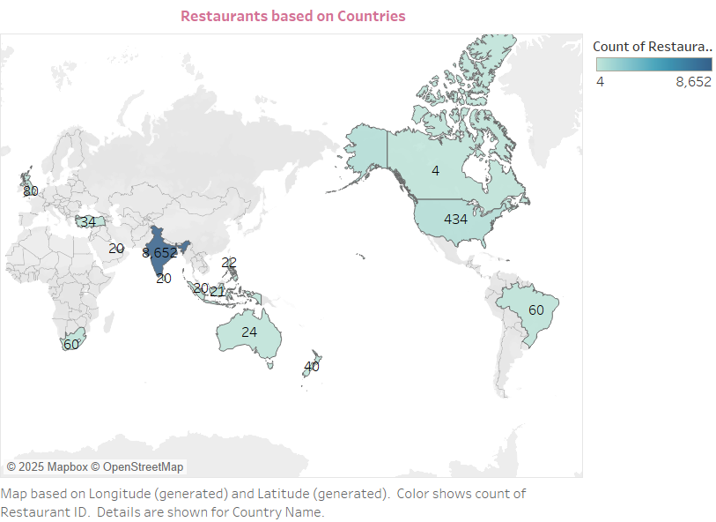
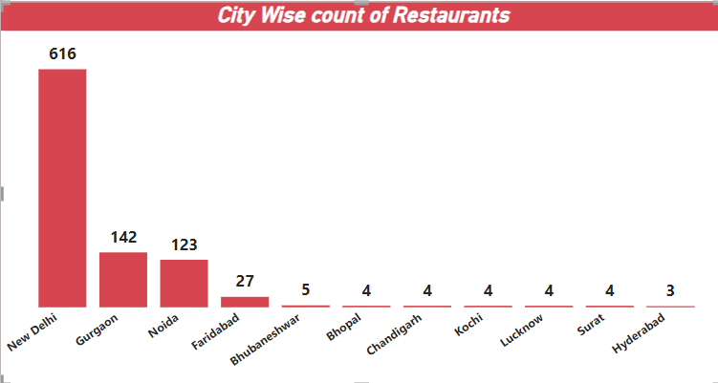
Restaurant Distribution by City and Country
City
Country
Delhi has the highest number of restaurants whereas Hyderabad is having Least number of restaurants.
India represents the highest number of restaurants whereas Canada is having Least number of restaurants.

Slide 7
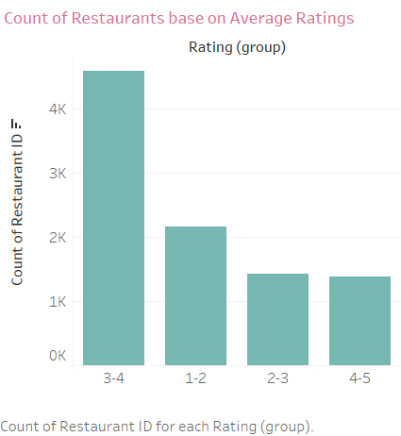
Restaurants Based on Average Ratings

Slide 8
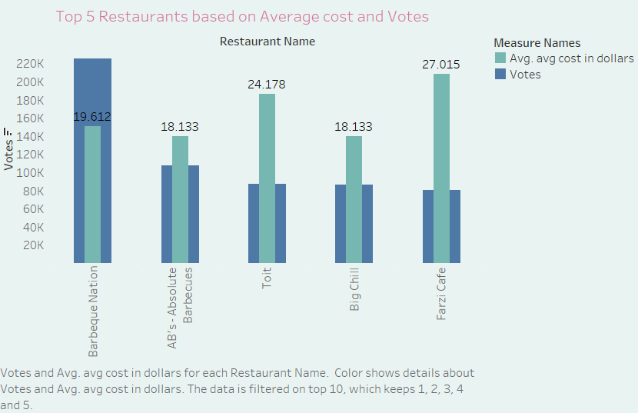
Top 5 Restaurants Based on Reviews

Slide 9
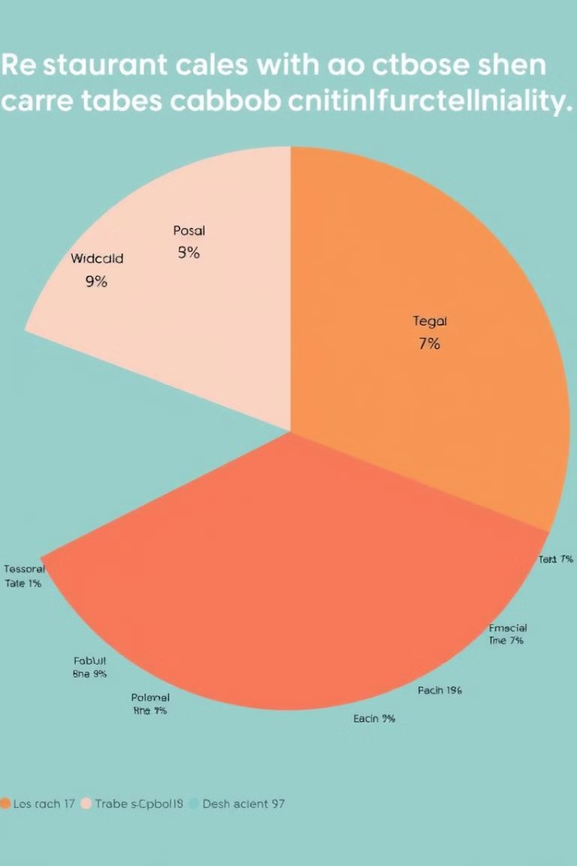




Table Booking & Online Delivery
Table Booking
Online Delivery
12% Total Restaurants has Table Booking
26 % Total Restaurants has Online delivery
No Booking
No Delivery
88% Total Restaurants has No Table Booking
74 % Total Restaurants has Online delivery

Slide 10
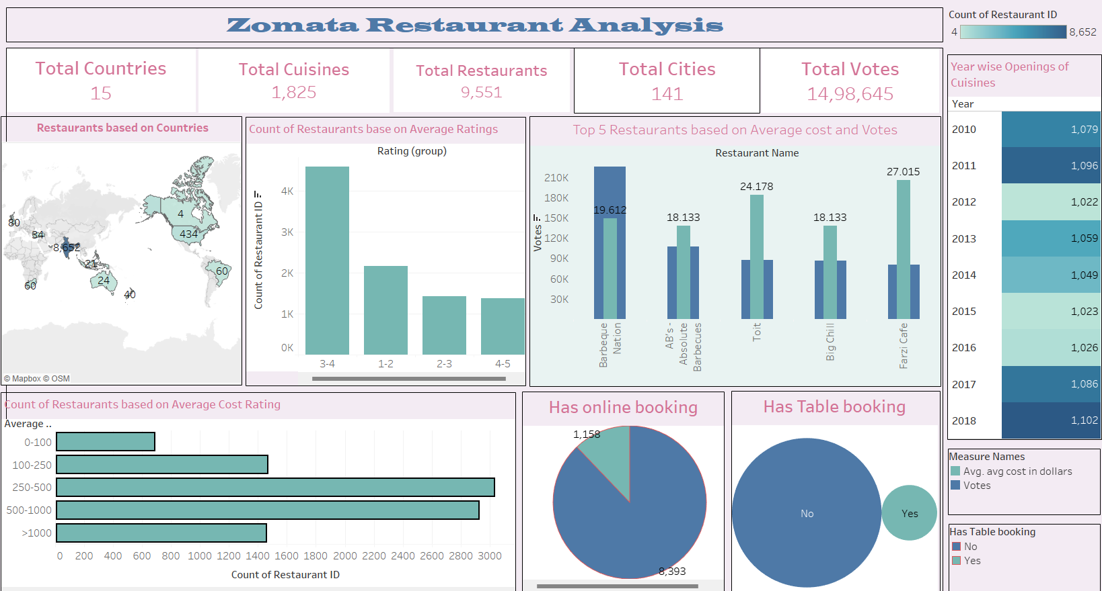
Tableau Dashboard

Slide 11
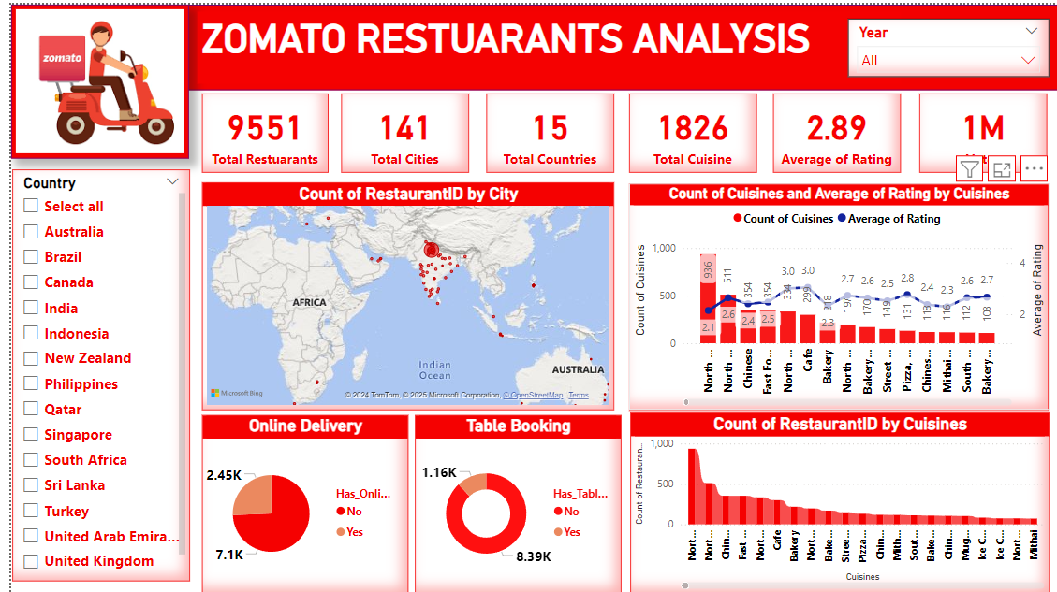
PowerBI Dashboard

Slide 12
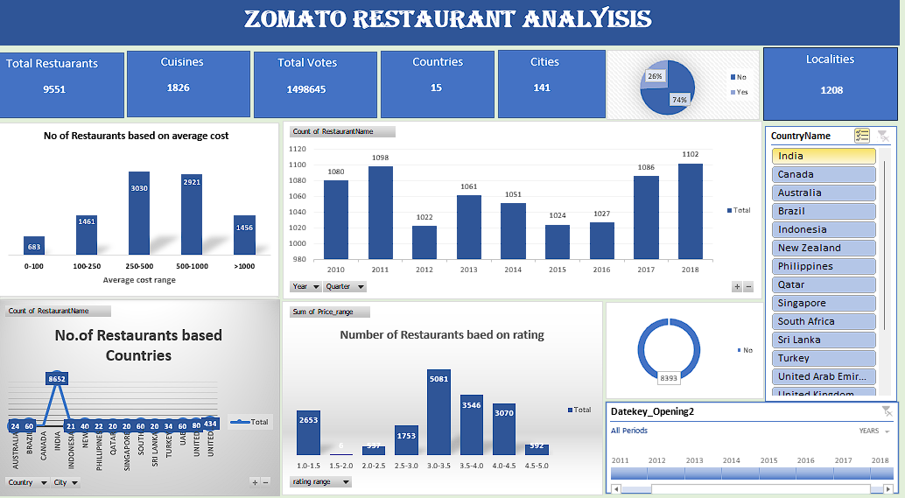
Excel Dashboard

Slide 13
Excel functions were used, including:
SUMIFS and COUNTIFS functions to extract and count data based on specific criteria.
PivotTables and PivotCharts to summarize and analyze data
Conditional formatting to highlight key insights in the data Report connections to link multiple PivotTables and charts to a single slicer, allowing for dynamic filtering of the data VLOOKUP and INDEX-MATCH functions to merge data from different tables.
DATE and YEAR functions to extract information from date fields

Slide 14
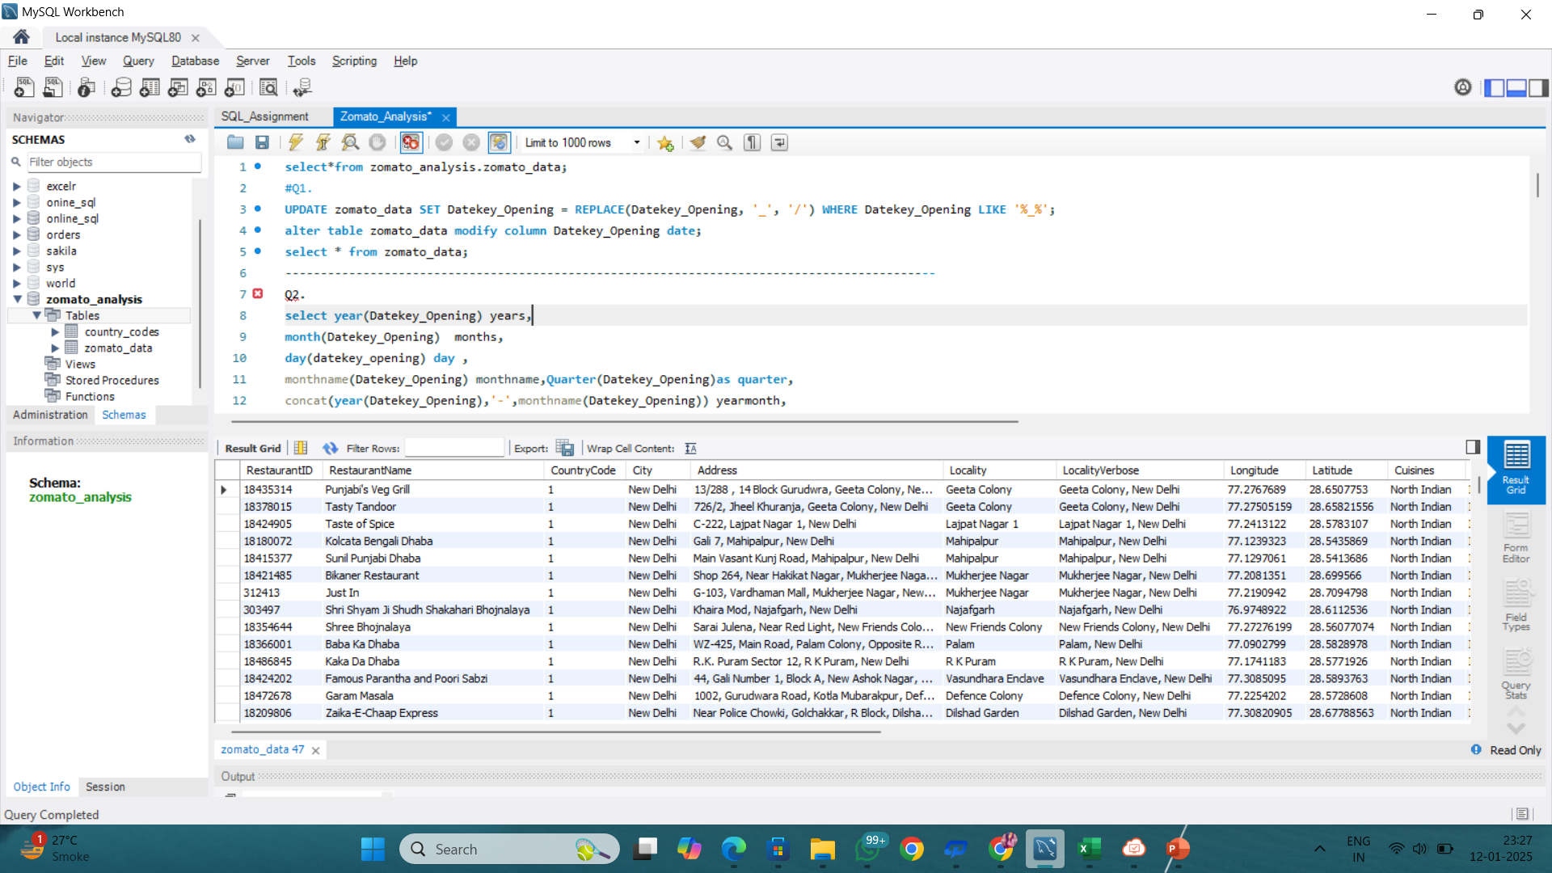
SQL question 1

Slide 15
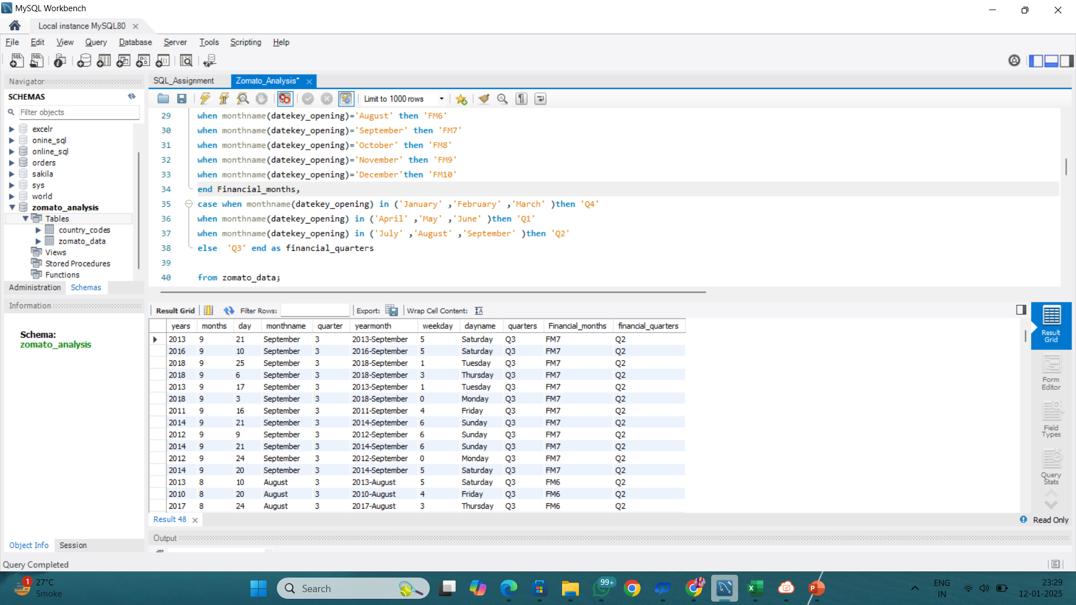
SQL Calendar

Slide 16
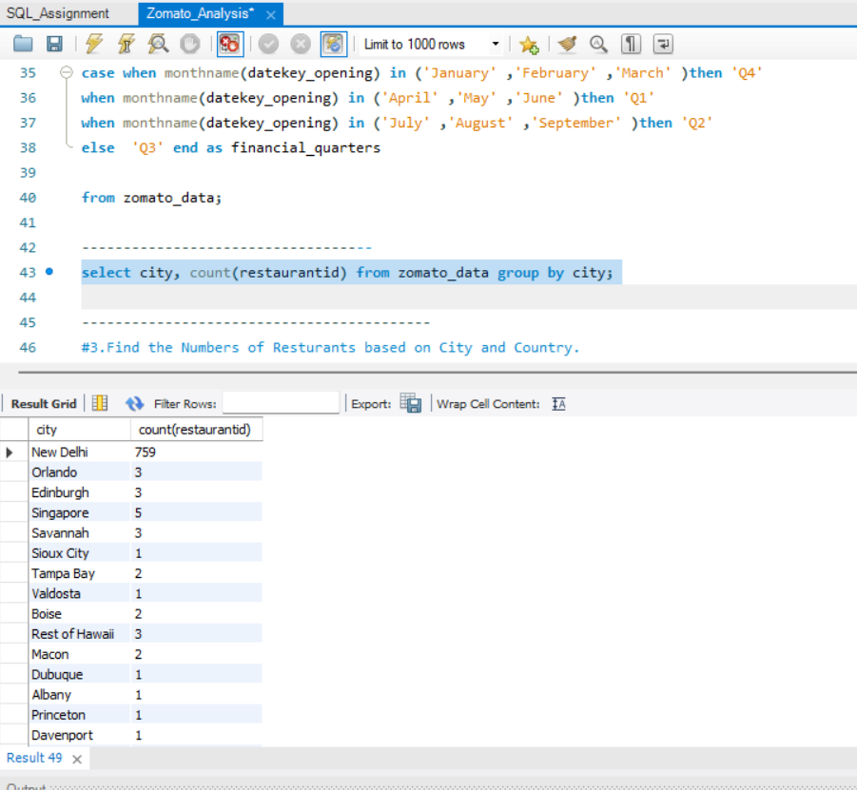
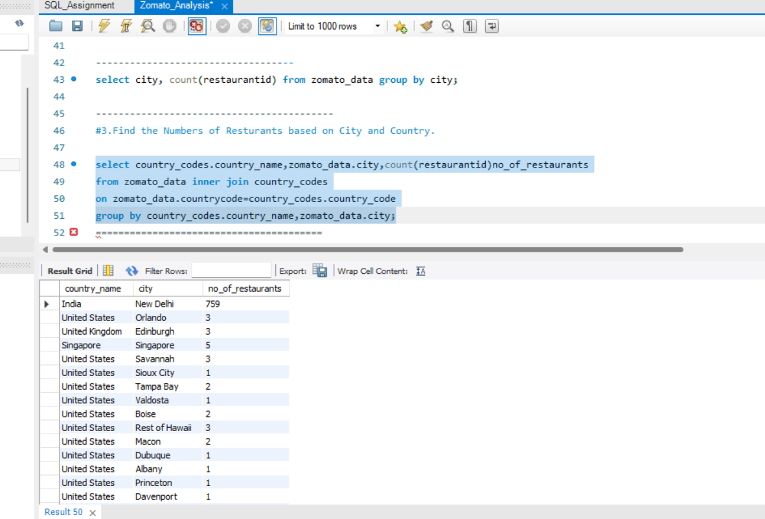
SQL KPI

Slide 17
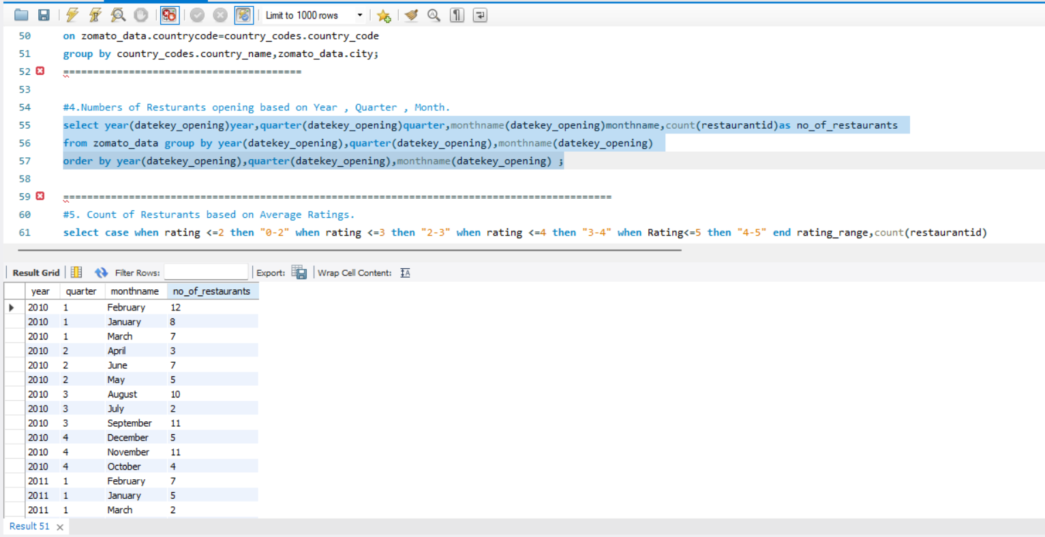
SQL KPI

Slide 18
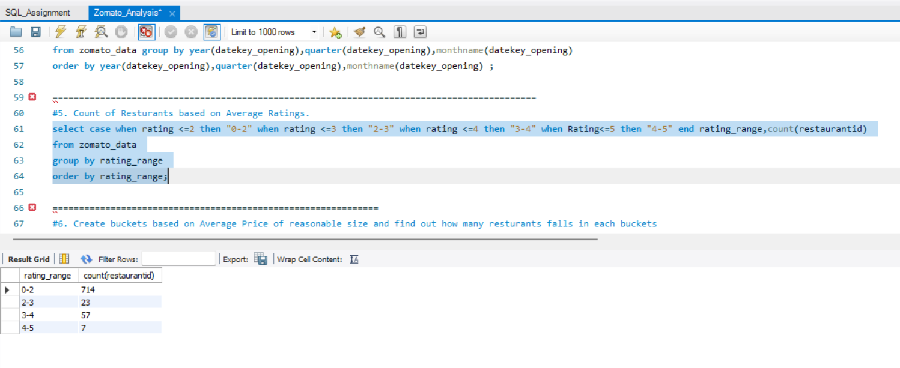
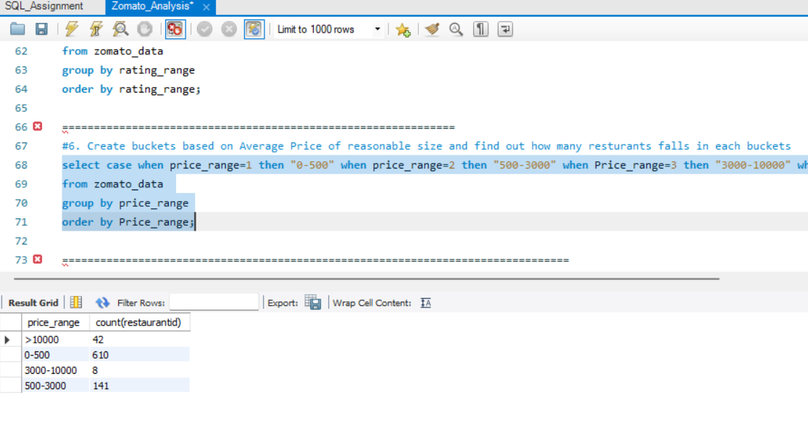
SQL KPI

Slide 19
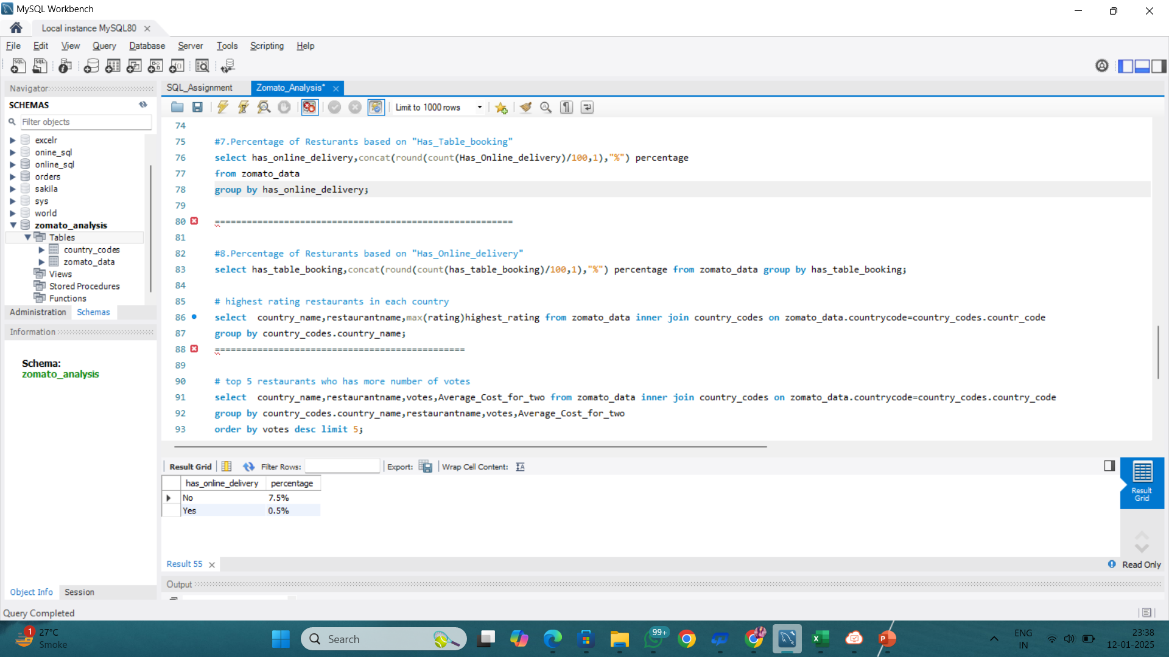
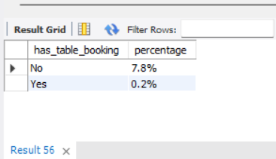
SQL KPI

Slide 20
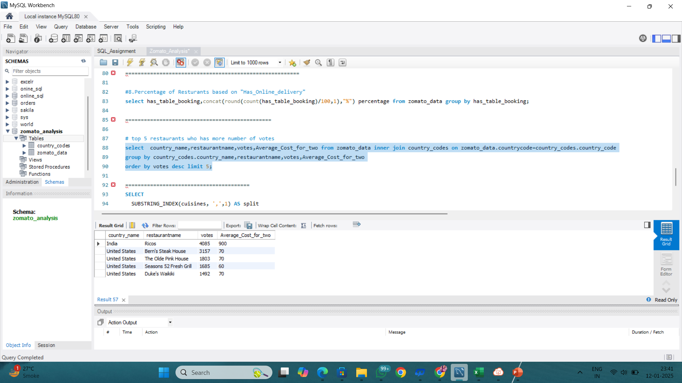
SQL KPI

Slide 21
SQL queries were executed using the following keywords:
SELECT to retrieve data from specific columns
FROM to specify the table to retrieve data
From WHERE to filter data based on specific conditions
GROUP BY to group data based on specific columns
ORDER BY to sort data in ascending or descending order

Slide 22
Conclusion: - Top Cuisines by Votes: North Indian and Mughlai.
- India has the highest number of restaurants whereas Canada is having Least number of restaurants - Affordable Options: Out of 9551 restaurants, 7273 have an average cost for two persons of $10 or less. - Table Booking Facilities: Only 8.63% of the 9551 restaurants offer table booking. - Online Delivery Facilities: Only 22.05% of the 9551 restaurants provide online delivery. - Year with Maximum Openings: The year 2018 witnessed the highest number of restaurant openings, totaling 1102

Slide 23
Thank You

